Slide 2

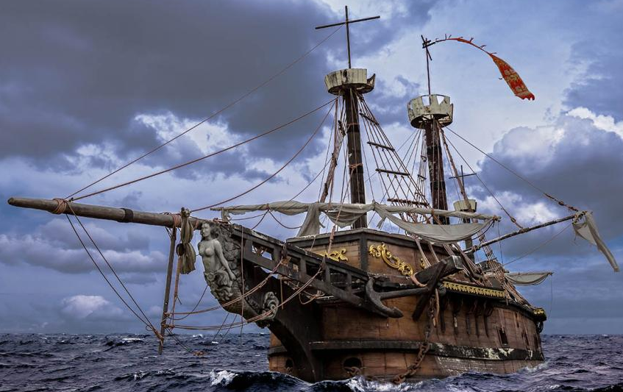



Slide 3




Slide 4





Slide 5
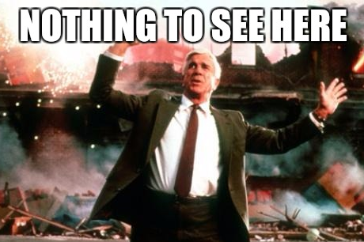


Slide 6






Slide 7
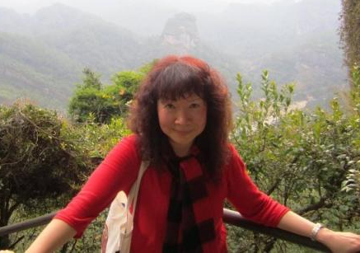




Slide 8
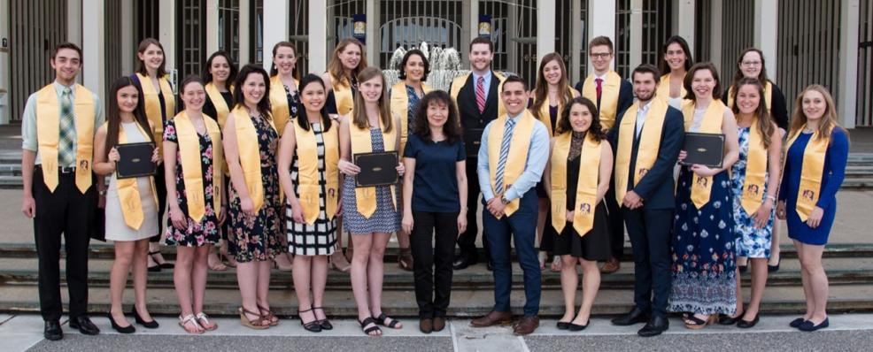

Slide 9


Slide 10

The Overall Project: Rise of the Info-Warrior
Textbook on How to Interview
Written by Students, Based on Team Work and Readings
It Is “How-To” but Much More Sensitive and adaptable
Two Publishers Already Interested
Excellent addition to your Resume

Slide 11




Slide 12




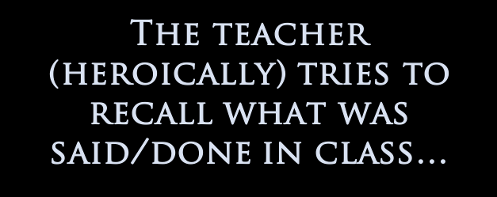



Slide 13




Slide 14



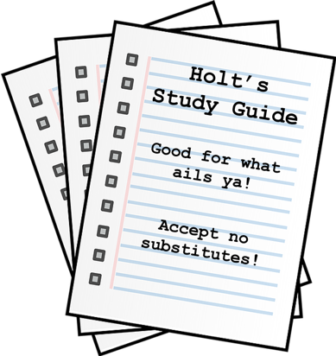

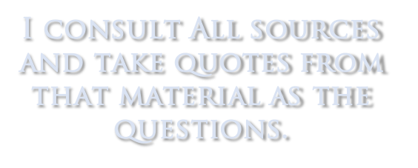
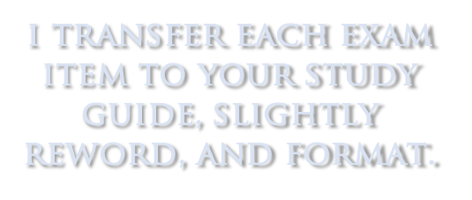

Slide 15



Slide 16



Slide 17


Slide 18












Slide 19








Slide 20






Slide 21



Slide 22





Slide 23





Slide 24





Slide 25





Slide 26




Slide 27




Slide 28



Slide 29


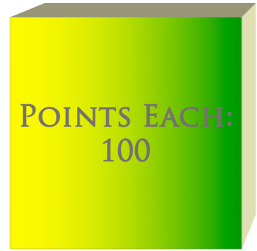


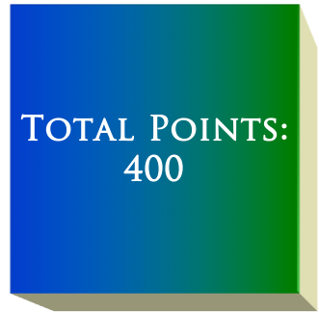
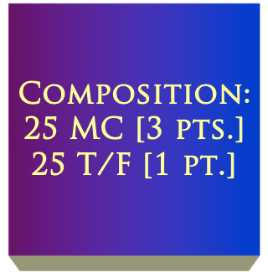

Slide 30



Slide 31



Slide 32


Slide 33


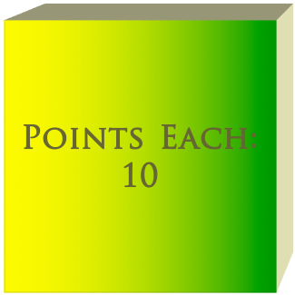

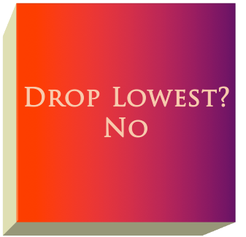
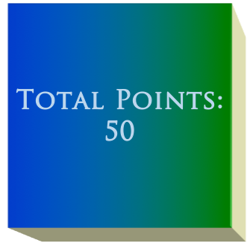
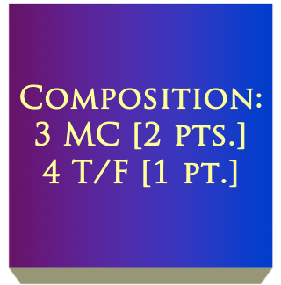

Slide 34


Slide 35



Points Each:
20
Total Points:
80

Slide 36


Slide 37
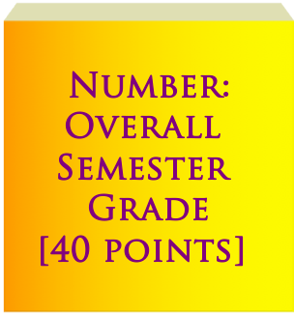

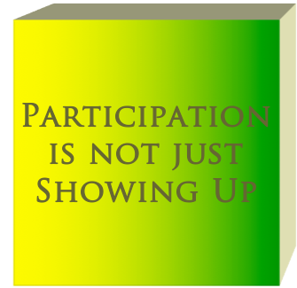

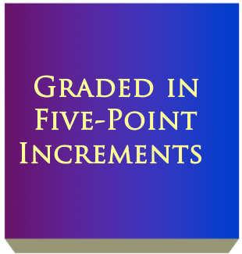


Slide 38
